Slide 1
NASA STUDENT LAUNCH
SD T501: The Zenith Program

Slide 2
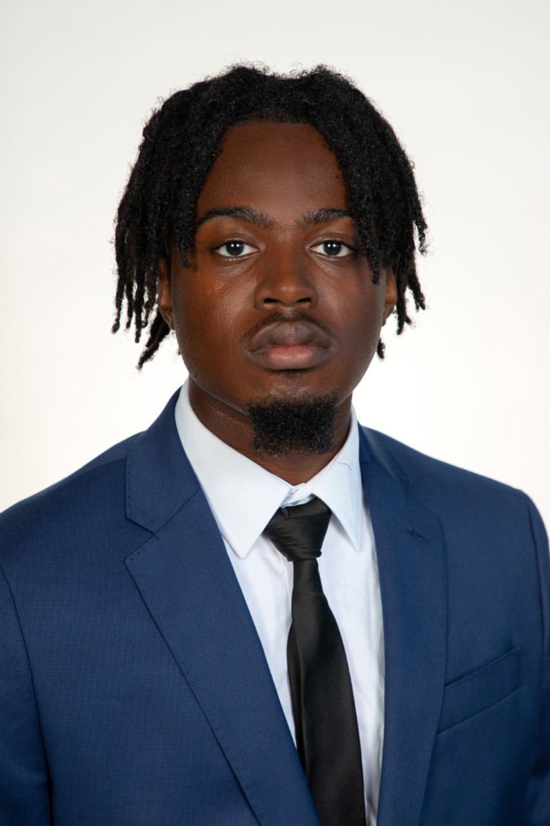
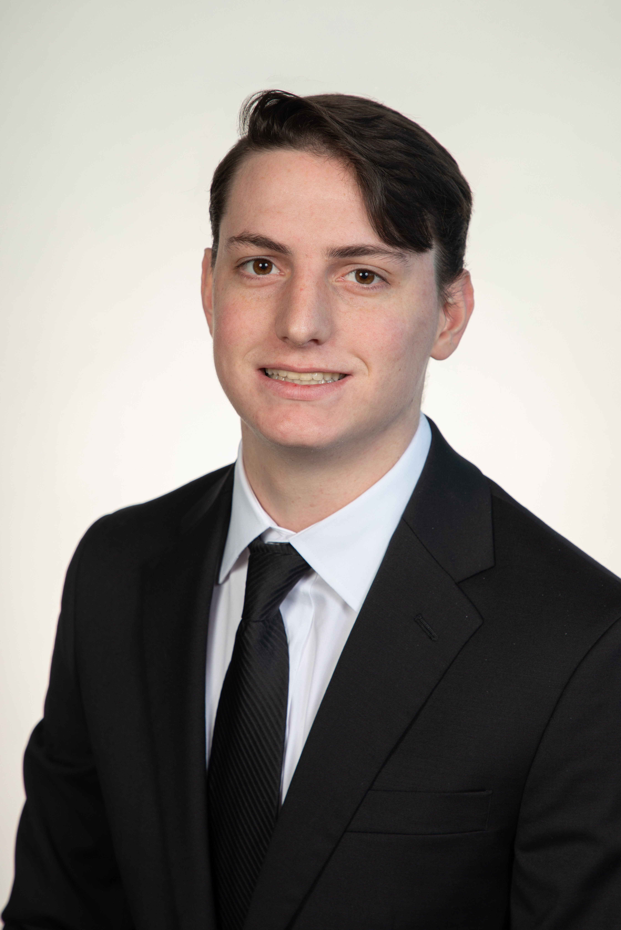
Zenith Program Leads
Jedreck Acquissa
Role: Recovery & Avionics System Lead
Engineering Interests: Fluid Design and Food Manufacturing
Peyton C. Breland
Role: Propulsion & Vehicle Design Lead
Engineering Interests: Fluid Design, Flight Vehicle Design and Manufacturing
Dylan A. Gardner
Role: STEM Engagement Lead
Engineering Interests: Fluid design, Heat Transfer, and Manufacturing
Mark A. Ioffredo
Role: Payload System Lead
Engineering Interests: Fluid Design and Aerodynamics
Zachary L. Isriel
Role: Program Director
Engineering Interests: Human spaceflight, spacecraft R&D, commercial launch

Slide 3
Project Overview

Slide 4
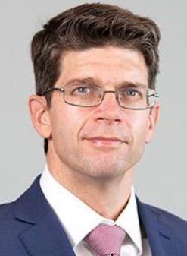
Stakeholders and Roles
National Aeronautics and Space Administration
Launch Service Client
Competition Organizer
Shayne McConomy,
Ph.D.
Functional Manager
ME Senior Design Coordinator
Project Sponsor
Chiang Shih,
Ph.D.
Project Advisor
AME Center Director
AIAA Student Org. Advisor
William Oates,
Ph.D.
Project Investor
ME Department Chair

Slide 5
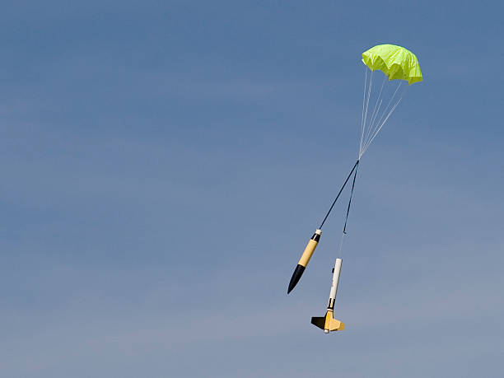
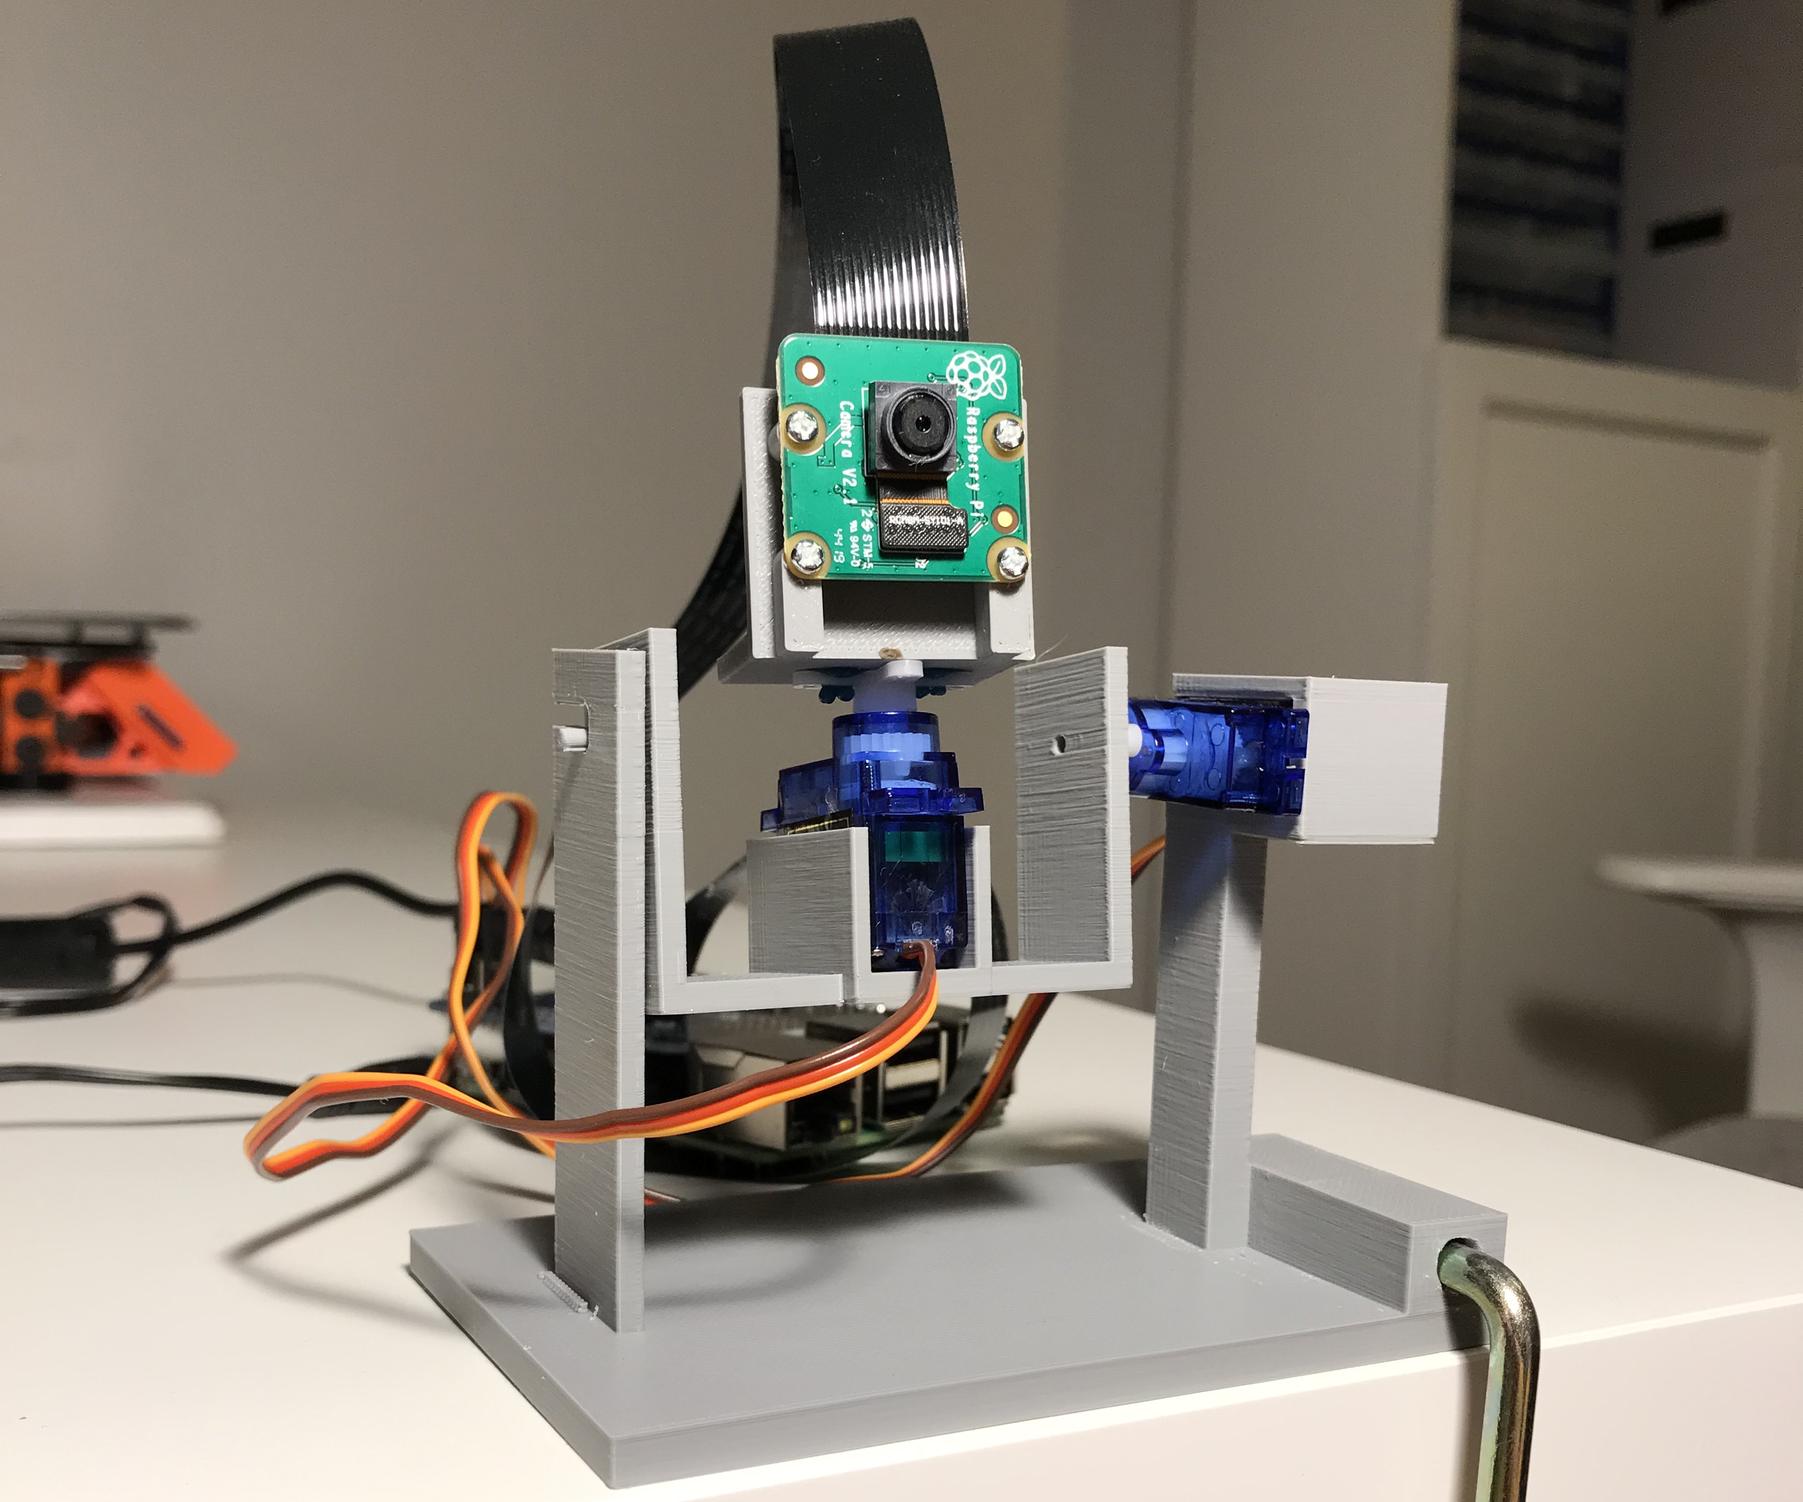
Objective
Fly a dual deployment, high-power solid rocket to an altitude of 4,600 ft that will deploy a payload capable of receiving and executing a string of radio frequency commands, after the vehicle has safely recovered within 2500 feet of the launch pad.

Slide 6
Flight Objective Overview
Phase II:
High velocity ascent with spin stabilization
Phase I:
Vehicle fully assembled and launch ready
Zenith I
80-85° Deg

Slide 7
Phase III:
Apogee (4600 ft) first separation (drogue deployment)
Flight Profile Overview
Phase II:
High velocity ascent with spin stabilization
Zenith I
Peyton Breland
7
Phase I:
Vehicle fully assembled and launch ready
80-85° Deg

Slide 8
Zenith I
Phase III:
Apogee (4600 ft) first separation (drogue deployment)
Peyton Breland
8
Phase II:
High velocity ascent with spin stabilization

Slide 9
Zenith I
Phase III:
Apogee (4600 ft) first separation (drogue deployment)
Peyton Breland
9

Slide 10
Zenith I
Phase III:
Apogee (4600 ft) first separation (drogue deployment)
Peyton Breland
10
Phase IV:
High velocity descent phase

Slide 11
Phase III:
Apogee (4600 ft) first separation (drogue deployment)
Phase IV:
High velocity descent phase
Zenith I
Peyton Breland
11
Phase V:
Main Chute + Payload Deployment (~550 ft)

Slide 12
Phase IV:
High velocity descent phase
Phase V:
Main Chute + Payload Deployment (~550 ft)
Zenith I
Peyton Breland
12

Slide 13
Phase IV:
High velocity descent phase
Phase V:
Main Chute + Payload Deployment (~550 ft)
Zenith I
Peyton Breland
13

Slide 14
Phase V:
Main Chute + Payload Deployment (~550 ft)
Zenith I
Peyton Breland
14
Phase VI:
Low velocity descent till landing

Slide 15
Phase V:
Main Chute + Payload Deployment (~550 ft)
Phase VI:
Low velocity descent till landing
Zenith I
Peyton Breland
15
Phase VII:
Payload completes series of tasks

Slide 16
Phase VI:
Low velocity descent till landing
Phase VII:
Payload completes series of tasks
Peyton Breland
Zenith I
16

Slide 17
Project Scope – Key Goals
Successful and accurate flight tests
From apogee to touchdown in under 85 seconds
Reach within 100 ft of the proposed 4600 ft apogee
Payload completes the desired series of tasks
Maintain a mid-flight stability margin between 3 and 4 calibers
Be awarded for at least one of the competition categories

Slide 18
Launch Vehicle Design

Slide 19
Design Concepts
Vehicle Concept 1
Vehicle Concept 2
Vehicle Concept 3

Slide 20
Design Concepts
Vehicle Concept 1
Vehicle Concept 2
Vehicle Concept 3
Aluminum Thrust Plate
Drogue Chute
Threaded Rods
Ogive Nose Cone
Payload
AV Bay
Main Chute
Mass w/ motor: 33.64 lbs (15257 g)
Stability Margin @ 20 mph wind speeds: 1.12 cal
Apogee (max altitude): 5484 feet
Length: 80.5 inches (~6 feet 7 inches)

Slide 21
Design Concepts
Vehicle Concept 1
Vehicle Concept 2
Vehicle Concept 3

Slide 22
Design Concepts
Vehicle Concept 2
Vehicle Concept 3
Vehicle Concept 1
Aluminum Thrust Plate
LD-Haack Series Nose Cone
Drogue Chute
AV Bay
Threaded Rods
Payload
Main Chute
Mass w/ motor: 42.42 lbs (19241 g)
Stability Margin @ 20 mph wind speeds: 1.45 cal
Apogee (max altitude): 4048 feet
Length: 85 inches (~7 feet 1 inch)

Slide 23
Design Concepts
Vehicle Concept 1
Vehicle Concept 2
Vehicle Concept 3

Slide 24
Design Concepts
Vehicle Concept 3
Vehicle Concept 1
Vehicle Concept 2
LD-Haack Series Nose Cone
Main Chute
Drogue Chute
3D Printed Thrust Plate and Tail Cone Config.
Payload
AV Bay
Threaded Rods
Mass w/ motor: 38.30 lbs (17372 g)
Stability Margin @ 20 mph wind speeds: 2.25 cal
Apogee (max altitude): 4533 feet
Length: 99 inches (~8 feet 3 inch)

Slide 25
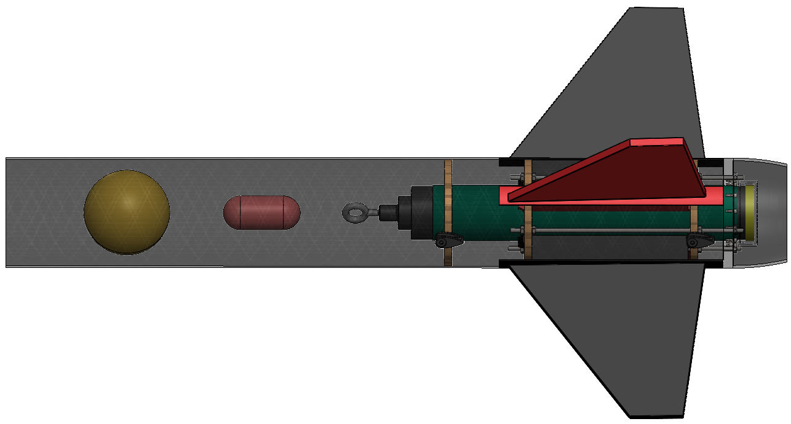
Launch Vehicle Final Design
6.154 in.
99.5 in.
Weight: 38.30 lb
Target Altitude: 4600 ft
Max Velocity: 545 ft/s
Sections held together by #4-40 Nylon shear pins (~ 39 lbf required for each pin)

Slide 26
Launch Vehicle Sections
6.154 in.
99 in.
Weight: 38.30 lb
Target Altitude: 4600 ft
Max Velocity: 545 ft/s
Sections held together by #4-40 Nylon shear pins (~ 39 lbf required for each pin)
Top Section
Nose cone + Upper Payload Bay
Middle Section
Avionics Bay
Bottom Section
Lower Payload Bay + Fin Can

Slide 27
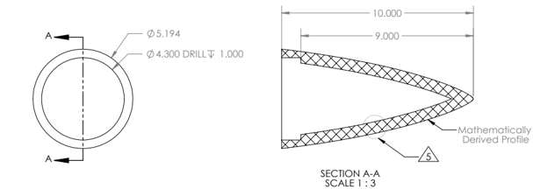
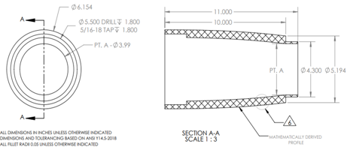
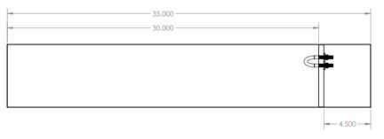
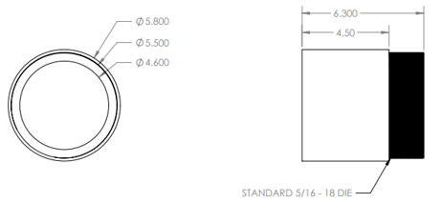
Launch Vehicle Sections
55 in.
Nose cone
3 sections for printing feasibility
Upper Payload Bay
Stores:
Main parachute (Fruity Chutes 84” Iris Ultra Standard)
32 ft of recovery harness
Payload

Slide 28
Launch Vehicle Sections
Top Section
Nose cone + Upper Payload Bay
Middle Section
Avionics Bay
Bottom Section
Lower Payload Bay + Fin Can

Slide 29
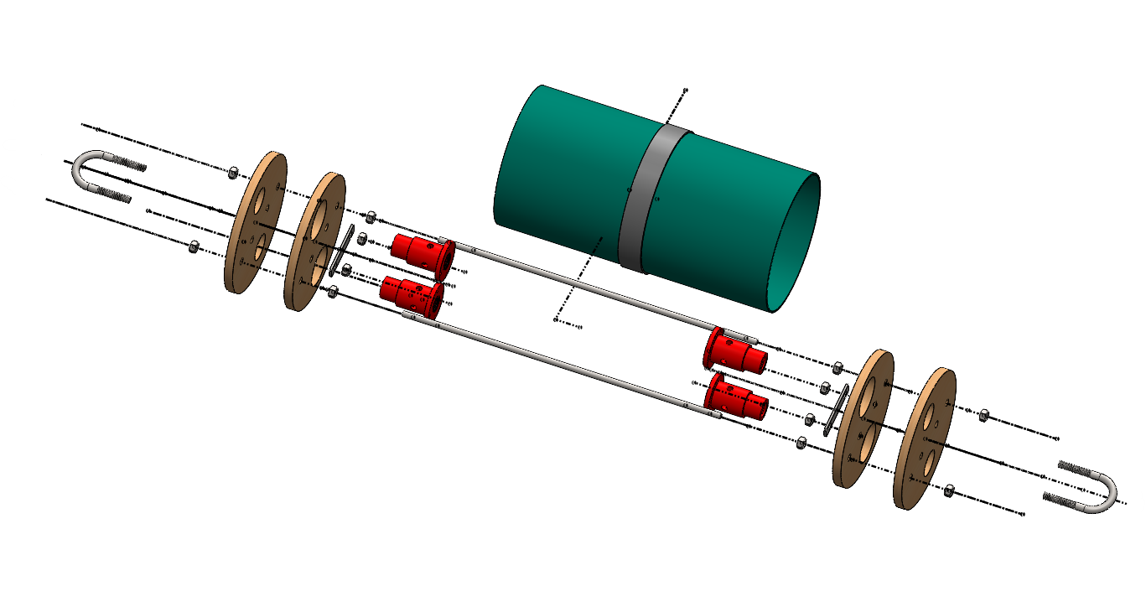
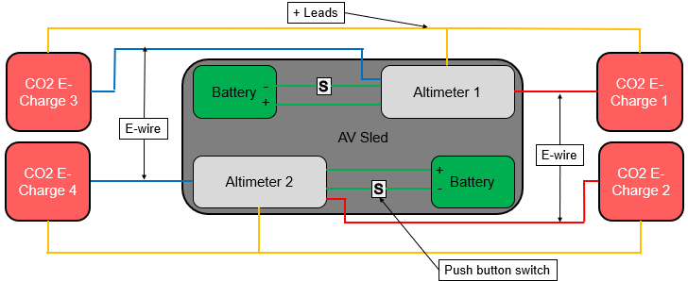
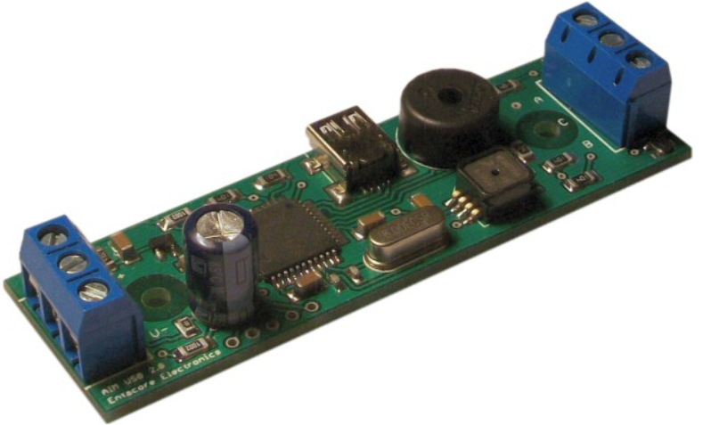
Launch Vehicle Sections
Avionics Bay
Stores:
Flight computers + batteries
GPS transmitters
CO2 ejection cartridges
12.75 in.
Altimeters: Entacore AIM 4
Top Section
Nose cone + Upper Payload Bay
Bottom Section
Lower Payload Bay + Fin Can
2.75 in.

Slide 30
Launch Vehicle Sections
Top Section
Nose cone + Upper Payload Bay
Middle Section
Avionics Bay
Bottom Section
Lower Payload Bay + Fin Can

Slide 31
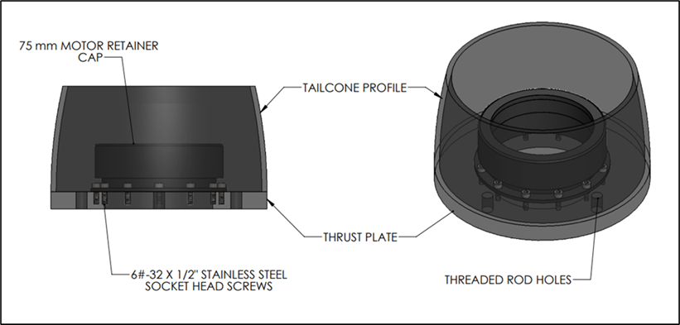
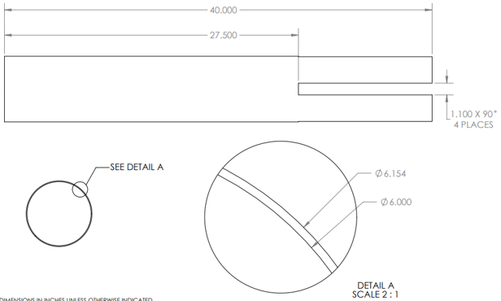
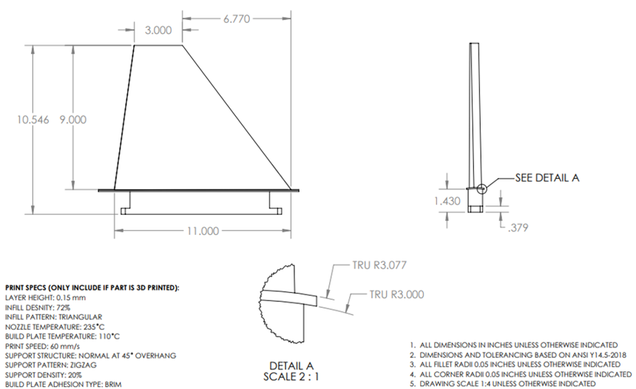
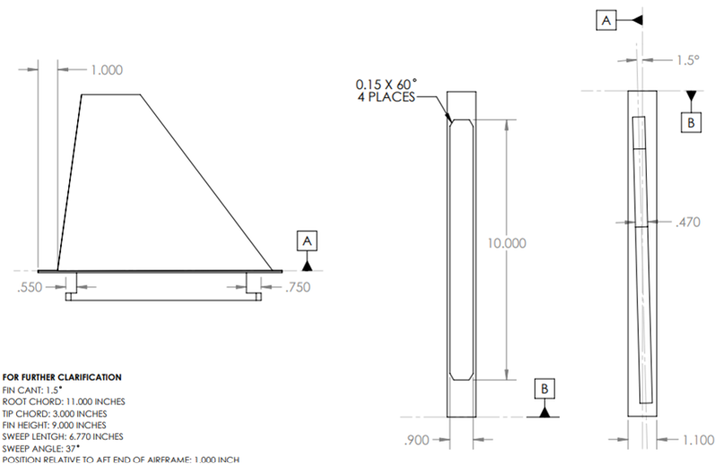
Launch Vehicle Sections
Fin Can
1.5° canted fins for spin stabilization
Fins mounted into centering rings
3D printed tail cone to minimize drag
Lower Payload Bay
Stores:
Drogue parachute (Fruity Chutes 24” Classic Elliptical)
16 ft of recovery harness
43.5 in.
Top Section
Nose cone + Upper Payload Bay
Middle Section
Avionics Bay

Slide 32
Payload Design

Slide 33
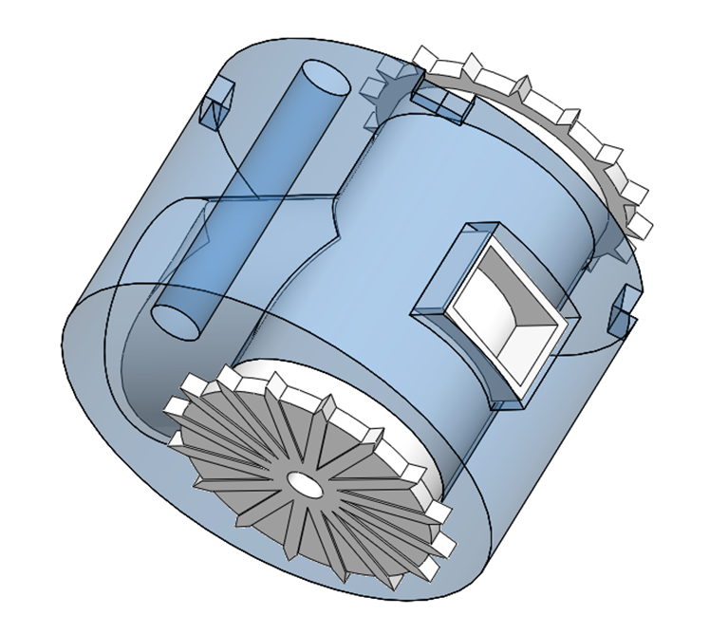
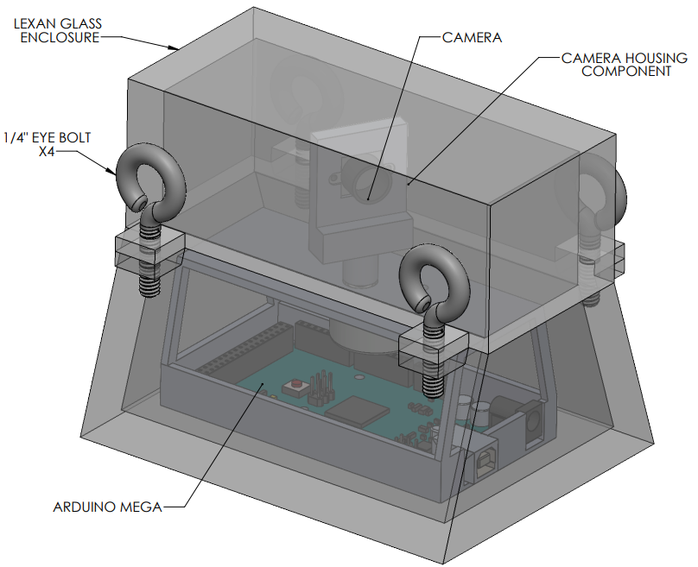
Payload Concepts
Payload Concept 1
Payload Concept 2
Payload Concept 3

Slide 34
Payload Concepts
Payload Concept 1
Payload Concept 2
Payload Concept 3
Movement- Stationary
Camera Actuation- Servo Motor
Inner Airframe Housing- Free inside payload bay

Slide 35
Payload Concepts
Payload Concept 1
Payload Concept 2
Payload Concept 3

Slide 36
Payload Concepts
Payload Concept 2
Payload Concept 3
Payload Concept 1
Movement- 2-wheel DC motor drive
Camera Actuation- Turns camera by moving wheels independently
Inner Airframe Housing- No housing

Slide 37
Payload Concepts
Payload Concept 1
Payload Concept 2
Payload Concept 3

Slide 38
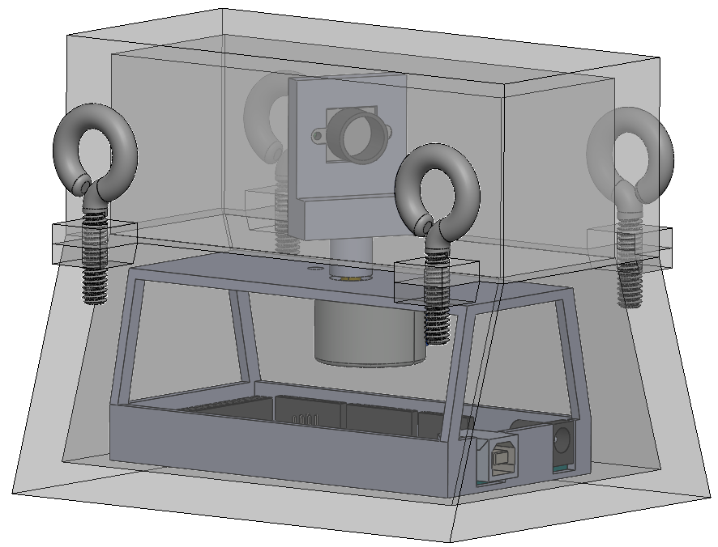
Payload Concepts
Payload Concept 3
Payload Concept 1
Payload Concept 2
Movement- Stationary
Camera Actuation- Stepper motor
Inner Airframe Housing- Free inside payload bay

Slide 39
Payload Final Design
144-148 MHz Receiver
3D printed base
Lexan camera shroud
4 Eye Bolts
4.5 in
4.2 in
5.5 in

Slide 40
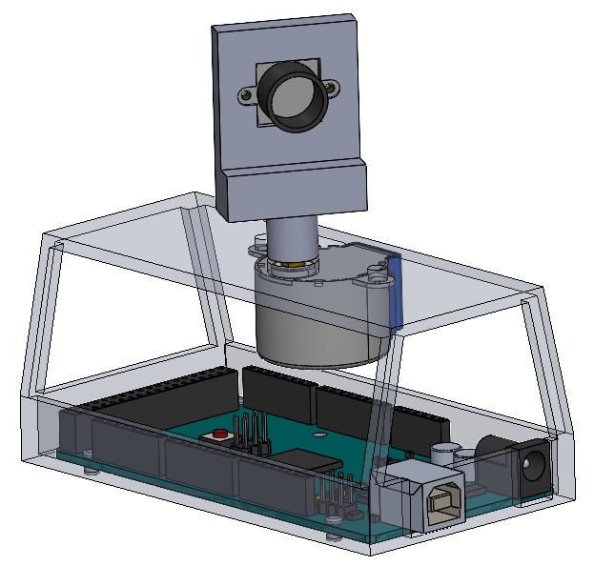
Payload Design
ArduCam Mini
3D-Printed Camera Mount
Stepper Motor
Electronics House
Arduino Mega Controller

Slide 41
Subscale Vehicle

Slide 42
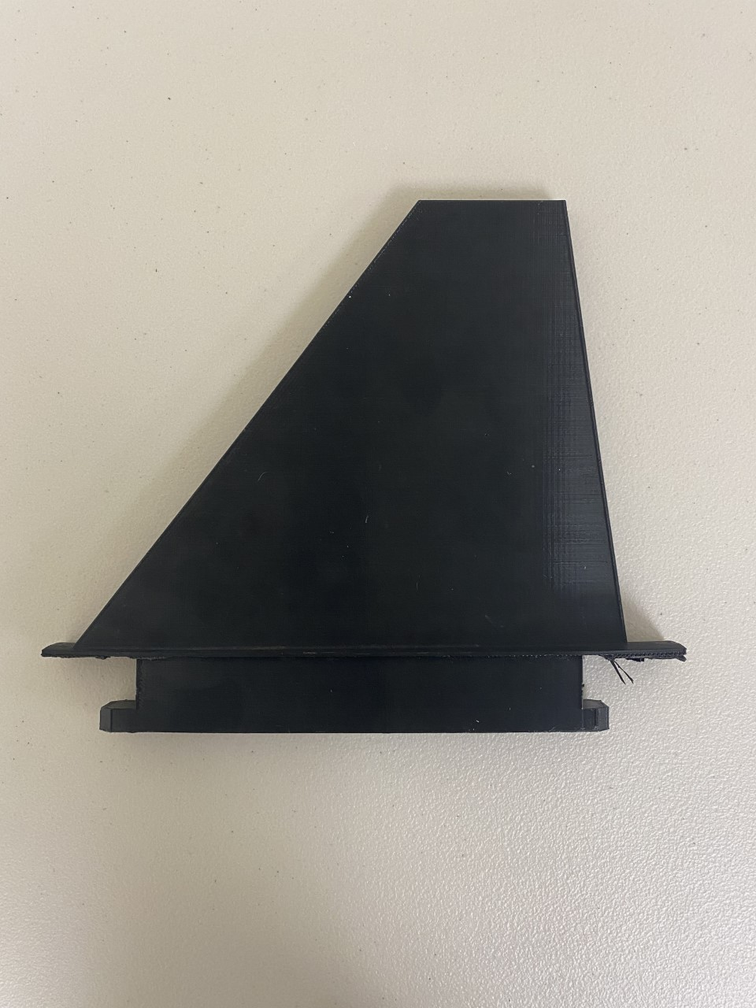
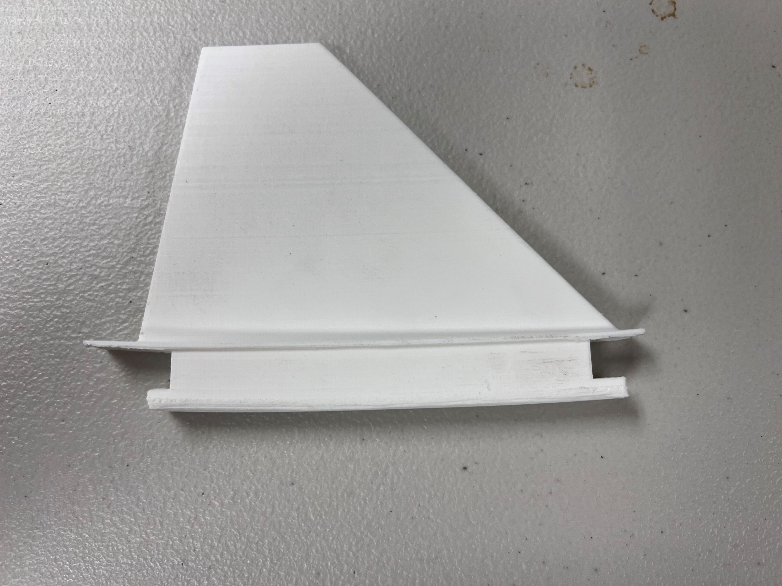
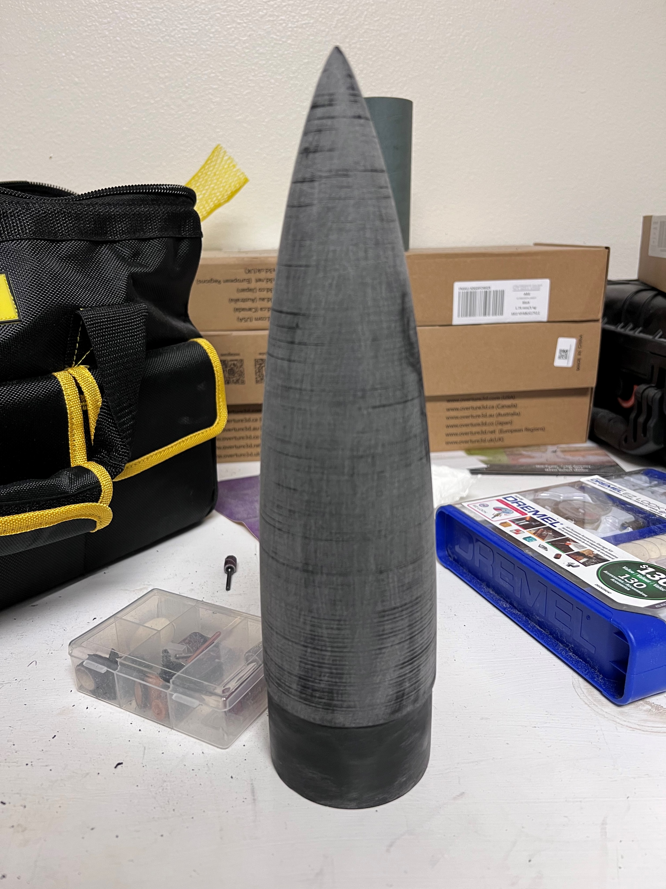
3D Printing

Slide 43
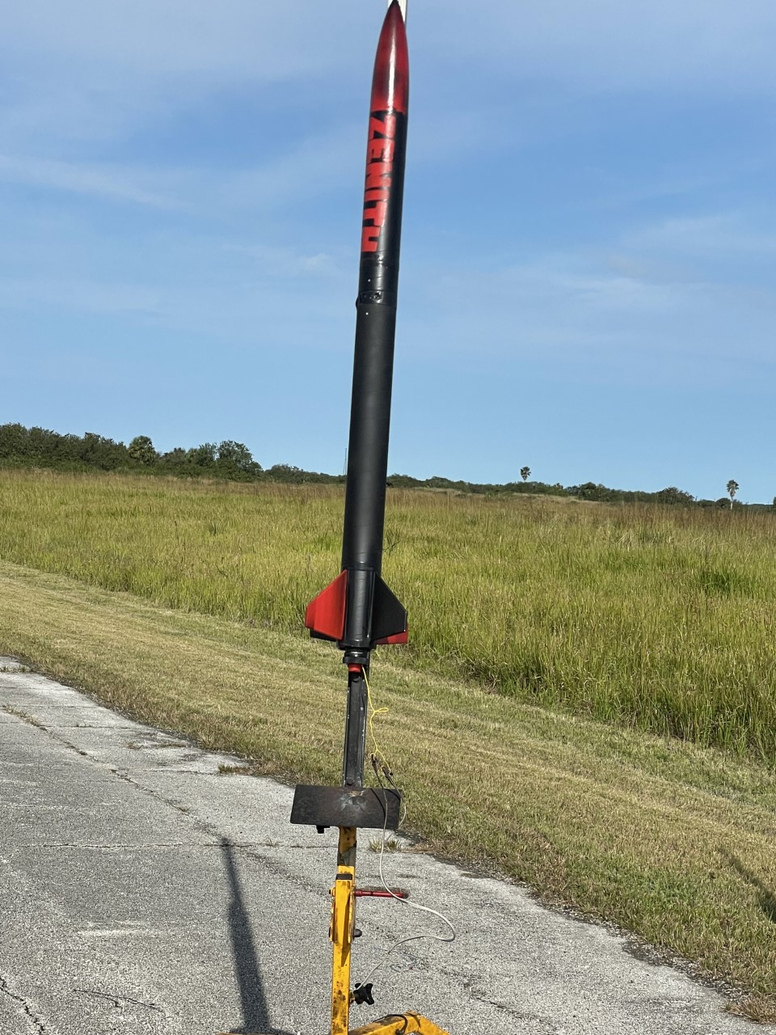
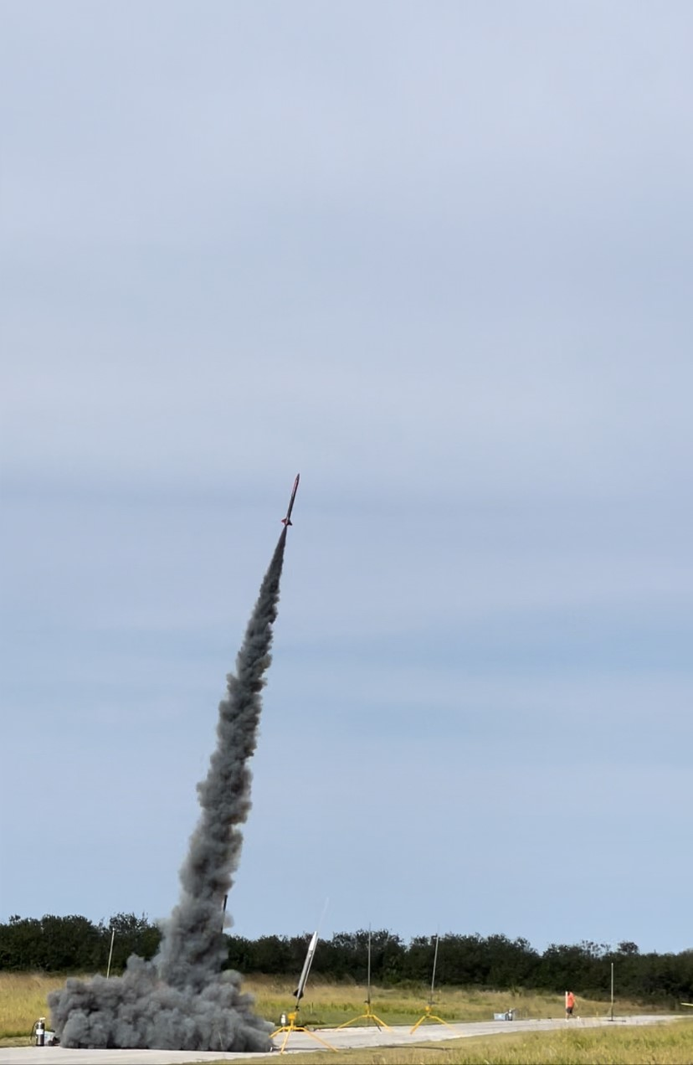
Subscale Launch!

Slide 44
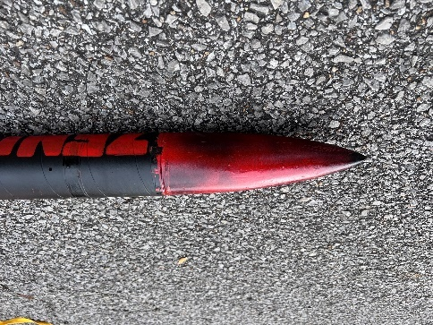
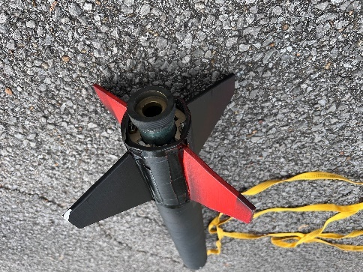
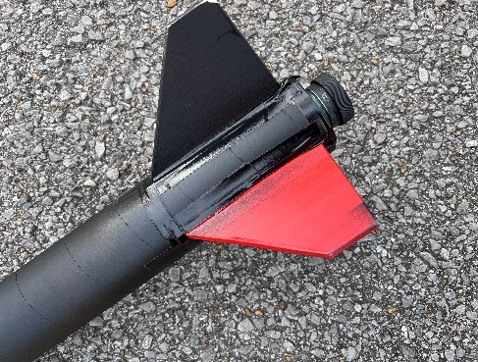
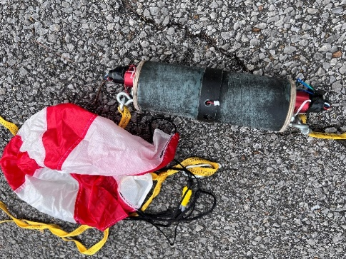
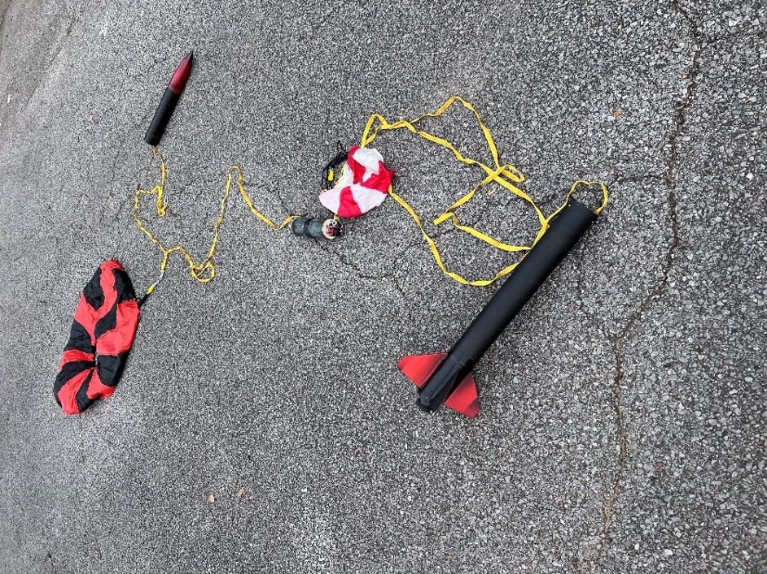
Flight Result: Partial Success
Vehicle recovered with no damage
Recovery ~1 mile from launch site
Two good chutes, two good charge firings. Improperly timed main parachute

Slide 45
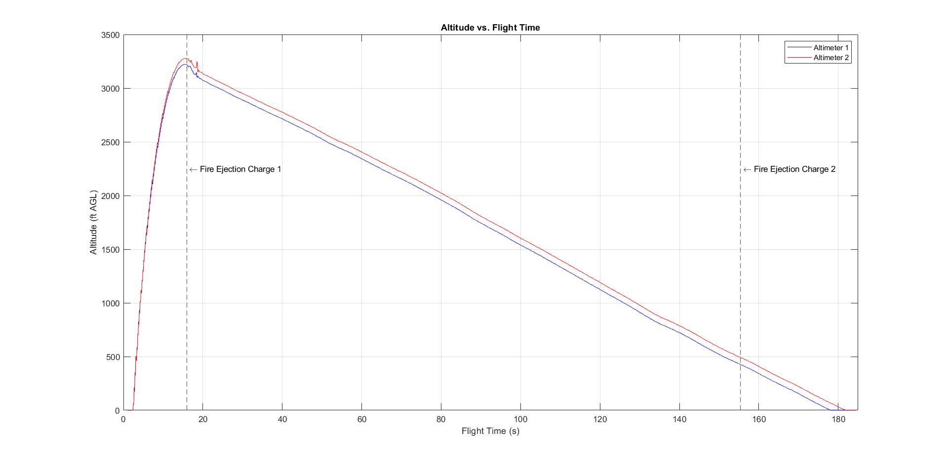
Post-Flight Data Analysis
Predicted Altitude: 3,182 ft
Achieved Altitude: 3,279 ft
Deviation = 3.05%

Slide 46
STEM Engagement Plans

Slide 47
STEM Engagement
Types
Education-Direct Engagement: Hands-on activities where participants engage in learning a STEM related concept
Education-Indirect Engagement: Participants are engaged in learning a STEM concept through instructor-led presentations
Outreach-Direct Engagement: Participants don’t learn STEM concepts but get hands-on exposure to STEM related topics or hardware
Outreach-Indirect Engagement: Participants will interact with team members in an informal setting
Goals
STEM Engagement Activity reports completed before Flight Readiness Review (03/06/2023)
Engage a total of 250 participants
Properly convey STEM concepts to the participating parties
Stimulate interest for future NASA Student Launch divisions

Slide 49
STEM Engagement Dates

Slide 50
STEM Engagement Dates
Challenger Learning Center
02/23/2023
Engagement Type: Outreach-direct
Engagement Description: Set up booth to showcase project and opportunities with NASA student launch.

Slide 51
Mag-Lab Open House
02/25/2023

Slide 52
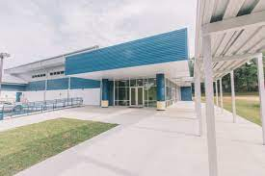
Sail High School
02/28/2023

Slide 53
School of Arts and Sciences
Date TBA

Slide 54
Project Timeline, Future Work, & Budget

Slide 55
Budget
Projected Cost:
$7,891.14
Project Budget:
$8,000.00

Slide 56
Projected Cost:
$7,891.14
- $7807.19
- $3036.95 (sub-scale development)
Project Budget:
- $2858.69 (full-scale + payload development)
$192.82
Remaining Expenditure:
- $1911.55 (competition transportation/lodging)
$8,000.00

Slide 57
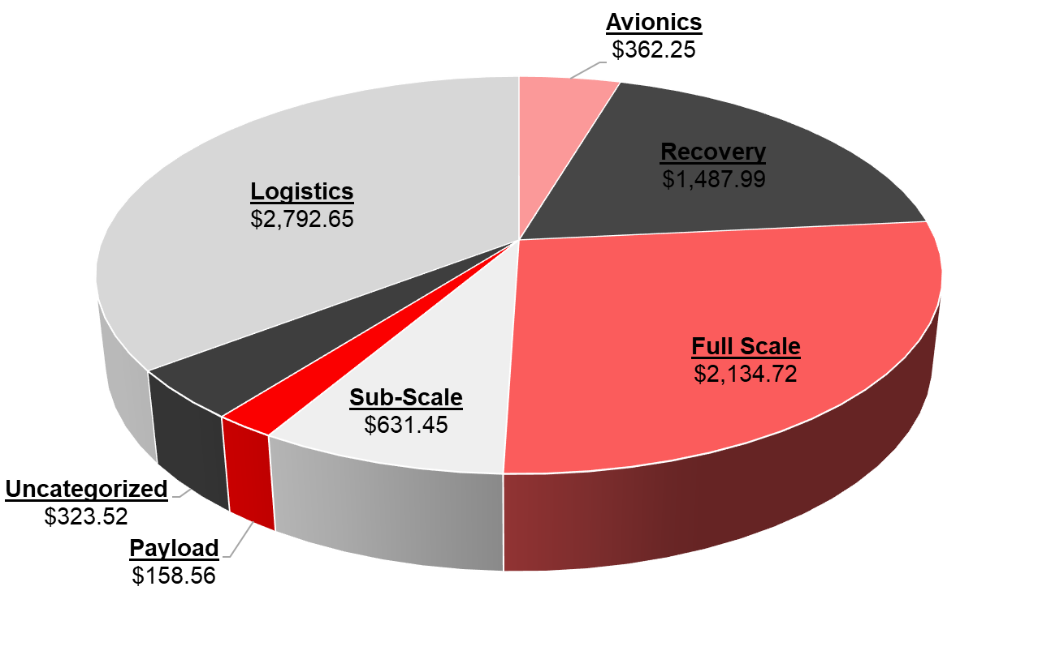
Expense Distribution

Slide 58
Expense Distribution

Slide 59
Timeline / Future work
Flight Readiness Review
Web Page
Completion
Operation
Manual
Engineering Design Day

Slide 60
Timeline / Future work
Flight Readiness
Review
Report final design modifications since CDR
Includes final assembly and launch operations checklists
Report results of full-scale demonstration flight

Slide 61
Timeline / Future work
Web Page
Completion
Launch Competition
Operation
Manual
Engineering Design Day

Slide 62
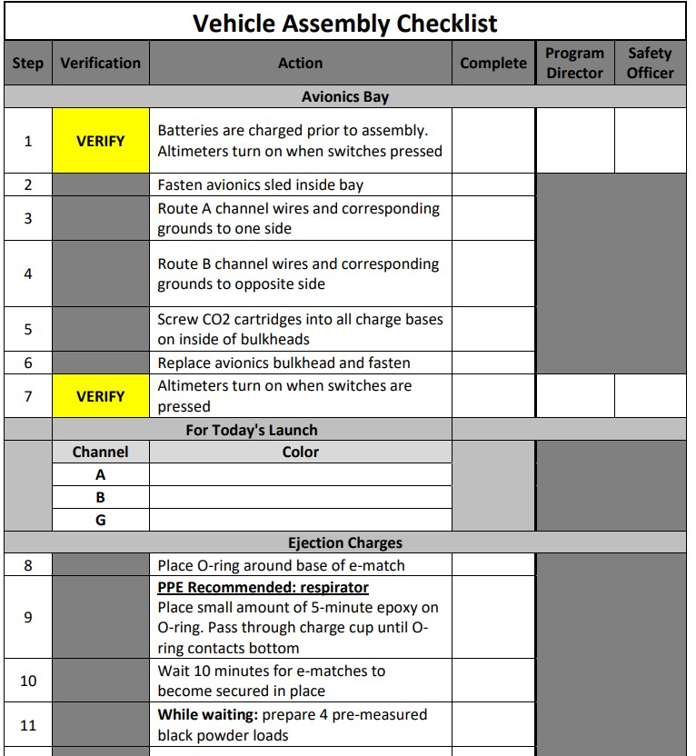
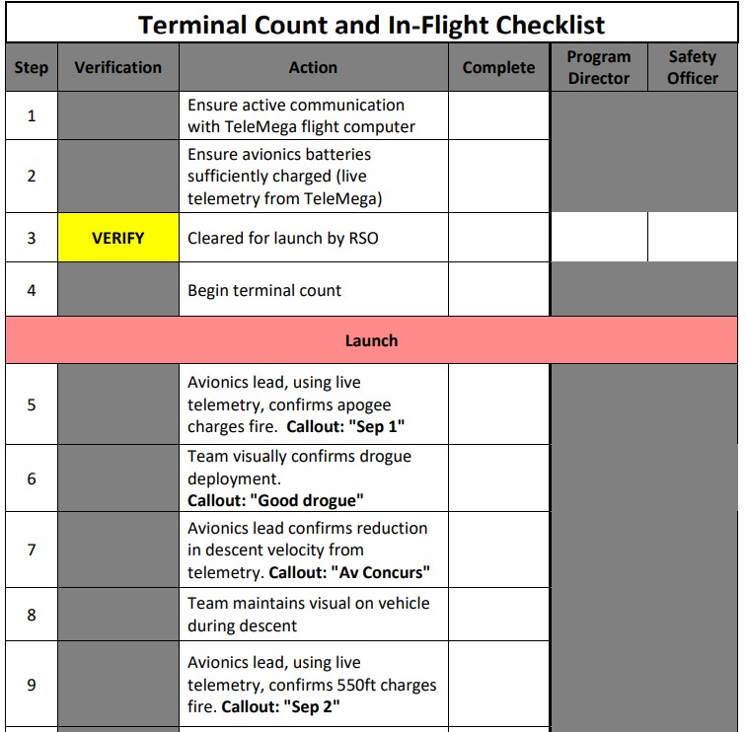
Timeline / Future work
Operation
Manual
List manufacturing and assembly instructions
Detail pre- and post-flight procedures
Includes all operations checklists developed

Slide 63
Timeline / Future work
Web Page
Completion
Launch Competition
Engineering Design Day
Final Presentation

Slide 64
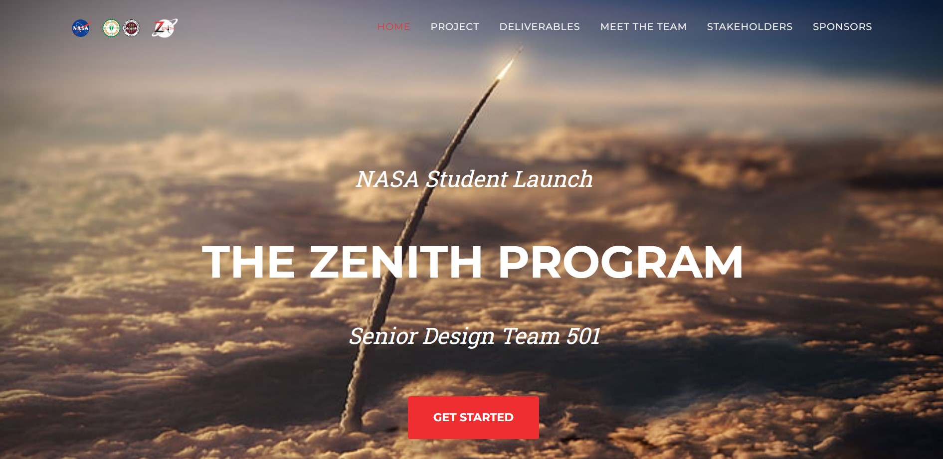
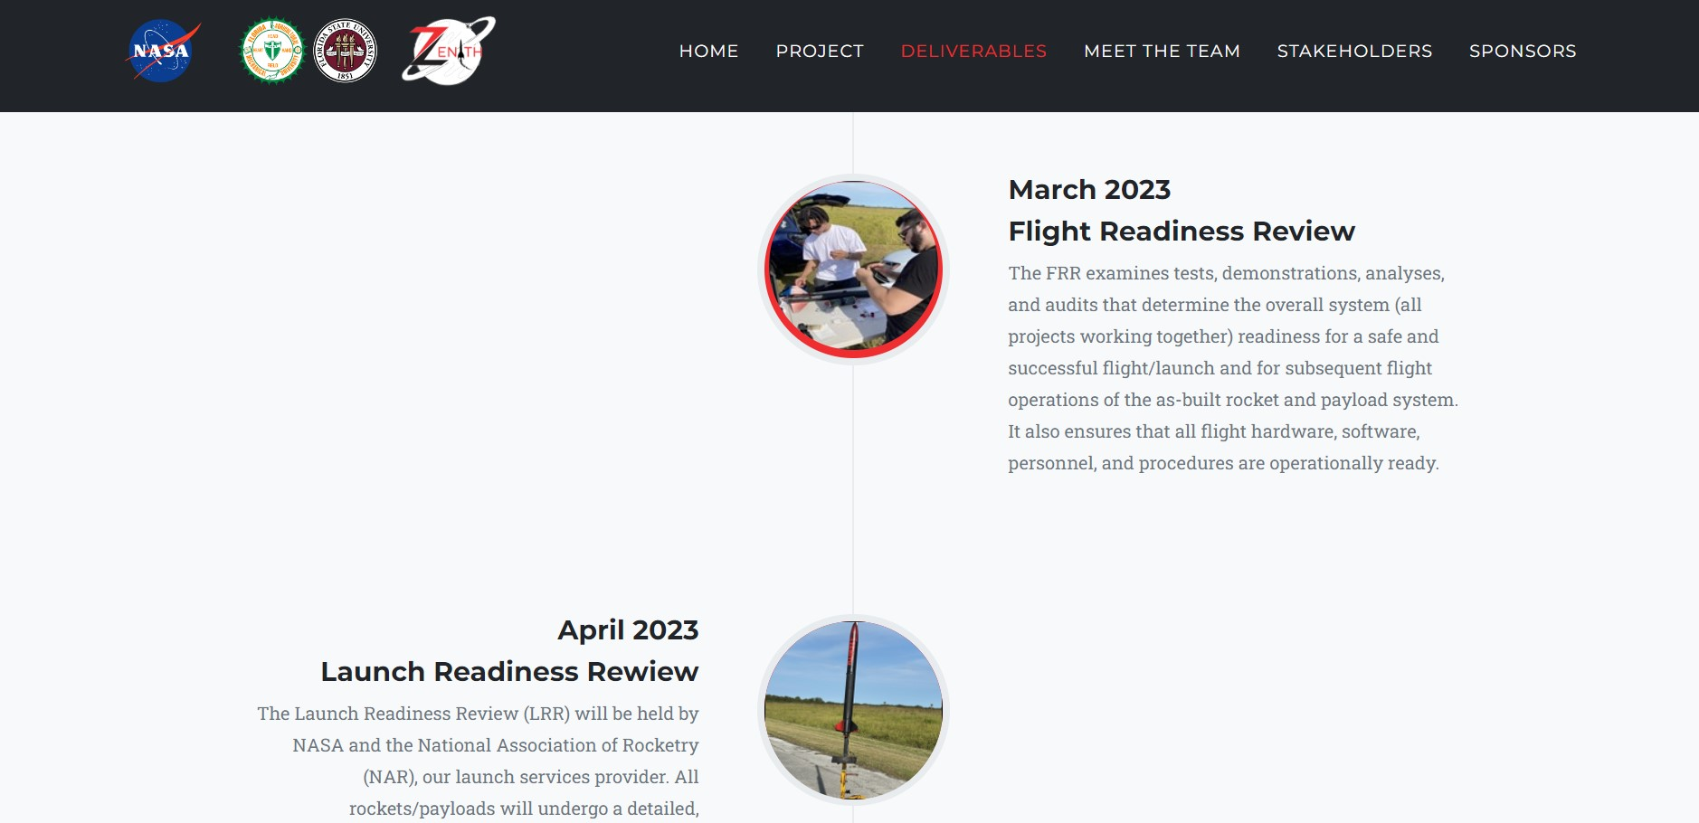
Timeline / Future work
Web Page
Completion
Update with latest NASA and SD deliverables
Correct minor formatting errors and typos
Verify hyperlink functionality for deliverable downloads and team member LinkedIns

Slide 65
Timeline / Future work
Post-Launch Assessment Review
Launch Competition
Engineering Design Day
Final Presentation

Slide 66
Timeline / Future work
Engineering Design Day
Design project showcase at COE
Oral presentations (VDR6)
Poster presentations

Slide 67
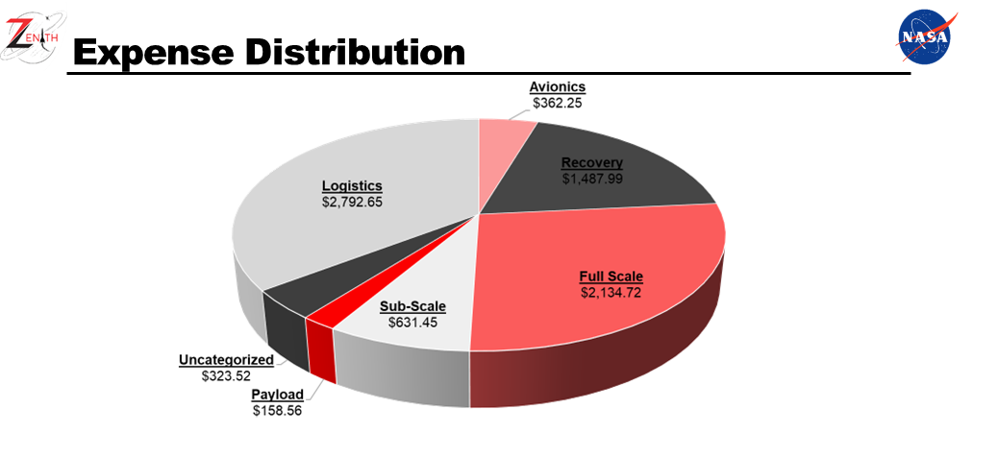
Timeline / Future work
Post-Launch Assessment Review
Launch Competition
Final Presentation
SL Award Ceremony

Slide 68
Timeline / Future work

Slide 69
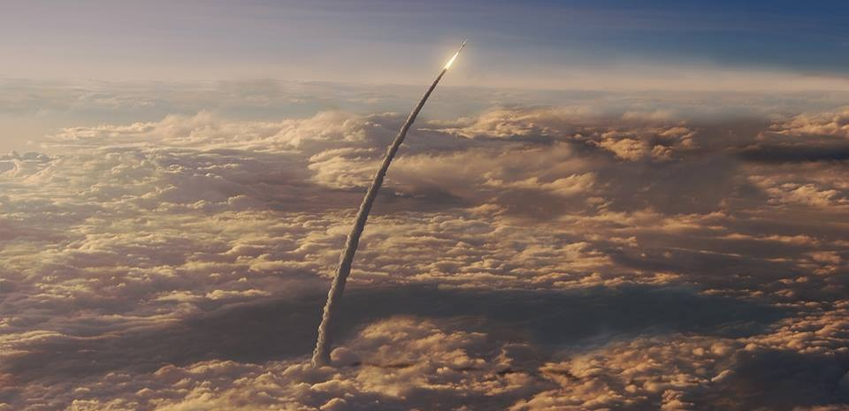
THANK YOU

Slide 70
COPY THIS SLIDE
Point
Point

Slide 71
COPY THIS SLIDE!

